Slide 1
Docker commands

Slide 2
Run – start a container

Slide 3
Ps – list containers

Slide 4
Stop – stop the container

Slide 5
Rm – remove the container

Slide 6
Images – list images

Slide 7
Rmi – remove images will remove dependent images as well

Slide 8
Pull download an image

Slide 9
Docker run

Slide 10
Append a command

Slide 11
sleep

Slide 12
Run attach , detach

Slide 13
Run - tag

Slide 14
Run –I and -it
-I keep stdin open
-t allocate a pseudo tty

Slide 15
Run port mapping

Slide 16
Run volume mapping

Slide 17
inspect
Docker inspect <containerid or name>

Slide 18
logs
Docker logs

Slide 19
Env variable
ARG is only available during the build of a Docker image
ENV values are available to containers
-e
Example
https://github.com/SeleniumHQ/docker-selenium

Slide 20
Docker networking

Slide 21
User Defined Networks

Slide 22
Docker networking

Slide 23
Docker storage

Slide 24
Layered Architecture

Slide 25
Container

Slide 26
Container Read write layer

Slide 27
Dockerfile
FROM ubuntu:latest
LABEL maintainer="myname@somecompany.com"
RUN apt-get update && apt-get upgrade -y
RUN apt-get install nginx -y
EXPOSE 80
CMD ["nginx", "-g", "daemon off;"]

Slide 28
Dockerfile
ADD – Defines files to copy from the Host file system onto the Container
ADD ./local/config.file /etc/service/config.file
CMD – This is the command that will run when the Container starts
CMD ["nginx", "-g", "daemon off;"]
ENTRYPOINT – Sets the default application used every time a Container is created from the Image. If used in conjunction with CMD, you can remove the application and just define the arguments there
CMD Hello World!
ENTRYPOINT echo

Slide 29
Dockerfile
ENV – Set/modify the environment variables within Containers created from the Image.
ENV VERSION 1.0
EXPOSE – Define which Container ports to expose
EXPOSE 80
FROM – Select the base image to build the new image on top of
FROM ubuntu:latest
LABEL maintainer – Optional field to let you identify yourself as the maintainer of this image. This is just a label (it used to be a dedicated Docker directive).
LABEL maintainer=someone@xyz.xyz"

Slide 30
Dockerfile
RUN – Specify commands to make changes to your Image and subsequently the Containers started from this Image. This includes updating packages, installing software, adding users, creating an initial database, setting up certificates, etc. These are the commands you would run at the command line to install and configure your application. This is one of the most important dockerfile directives.
RUN apt-get update && apt-get upgrade -y && apt-get install -y nginx && rm -rf /var/lib/apt/lists/*
USER – Define the default User all commands will be run as within any Container created from your Image. It can be either a UID or username
USER docker

Slide 31
Dockerfile
VOLUME – Creates a mount point within the Container linking it back to file systems accessible by the Docker Host. New Volumes get populated with the pre-existing contents of the specified location in the image. It is specially relevant to mention is that defining Volumes in a Dockerfile can lead to issues. Volumes should be managed with docker-compose or “docker run” commands. Volumes are optional. If your application does not have any state (and most web applications work like this) then you don’t need to use volumes.
VOLUME /var/log

Slide 32
Dockerfile
WORKDIR – Define the default working directory for the command defined in the “ENTRYPOINT” or “CMD” instructions
WORKDIR /home

Slide 33
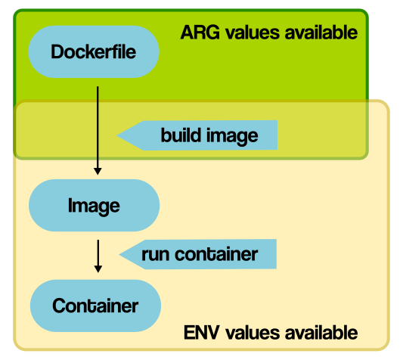
Arg and Env

Slide 34
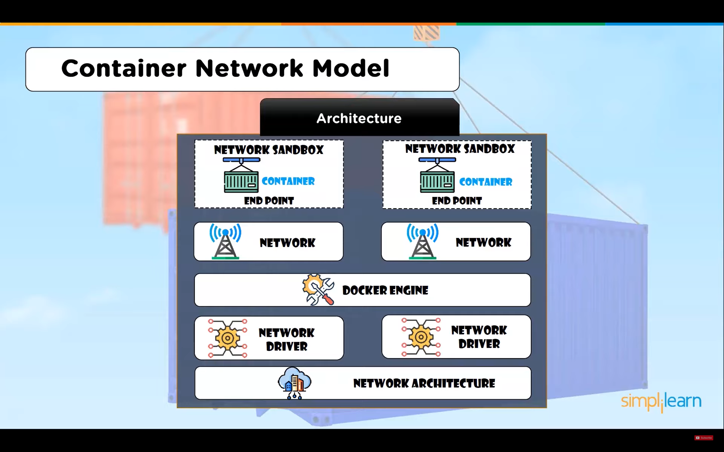

Slide 35
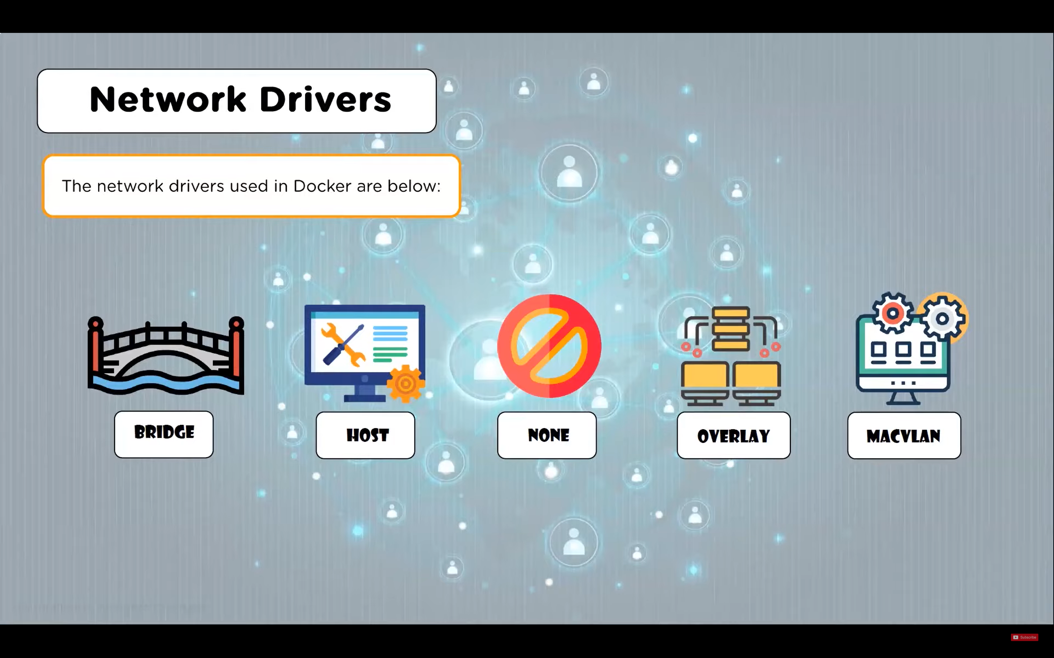

Slide 36
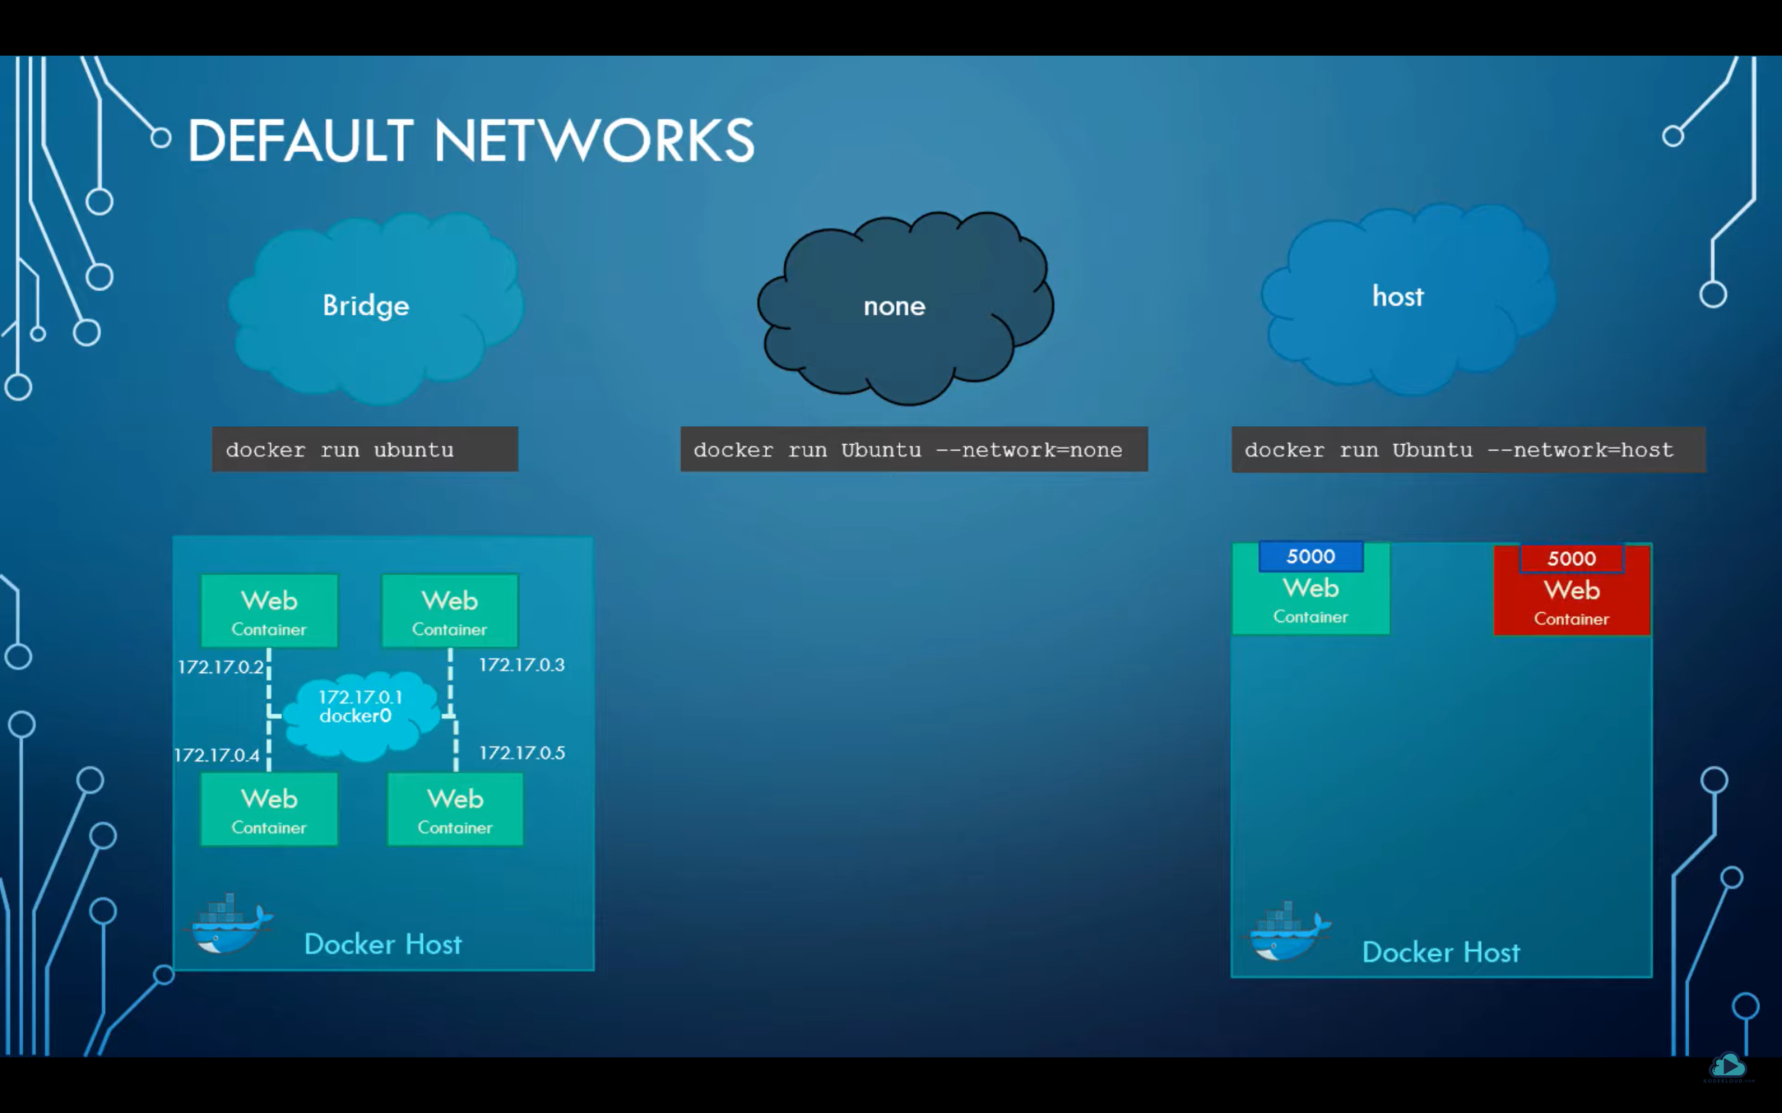

Slide 37
Docker events
Docker system events
Docker system events –since ‘1h’
Docker system events --filter

Slide 38
Multistage docker build
Lab exercise

